Slide 1
Thread Basics
CLR via C# (Jeffrey Richter)

Slide 2
Why Does Windows Support Threads?
No Thread concept in early days(16 Bit windows).
Process
Problem of Process
Thread solves the problems
Thread Overhead

Slide 3
Process
A process is just a collection of resources that is used by a single instance of an application.
Each process is given a virtual address space, ensuring that the code and data used by one process is not accessible to another process

Slide 4
Problem of Process
What if an application enters an infinite
loop?

Slide 5
Thread solves the problems
A thread is a Windows concept whose job is to virtualize the CPU. Windows gives each process its very own thread (which functions similar to a CPU), and if application code enters an infinite loop, the process associated with that code freezes up, but other processes (which have their own threads) are not frozen; they keep running!

Slide 6
Thread Overhead
Items | all the space and time overhead
Thread kernel object | X86 CPU -700 Bytes;x64 CPU-1240Bytes;ARM-350Bytes
Thread environment block (TEB) | X86,x64CPU-4KB;IA64CPU-8KB
User-mode stack | 1MB
Kernel-mode stack | 32bit windows-12KB;64bit windows-24KB
DLL thread-attach and thread-detach notifications | Time consuming(DLL_THREAD_ATTACH , DLL_THREAD_DETACH )

Slide 7
Thread Overhead…
Context switching
GC

Slide 8
CLR Threads and Windows Threads
Today, the CLR uses the threading capabilities of Windows

Slide 9
Reasons to Use Threads
Responsiveness (typically for client-side GUI applications)
Performance (for client and server side applications)

Slide 10
Thread Scheduling and Priorities
Micorosoft Spy++
0-31
2 Important concept:
Starvation
Dead lock

Slide 11
Thread Scheduling and Priorities
Process Priority Class
Windows supports six process priority classes: Idle, Below Normal, Normal, Above Normal, High, and Realtime.
relative thread priorities
Windows supports seven relative thread priorities: Idle, Lowest, Below Normal, Normal, Above Normal, Highest, and Time-Critical.

Slide 12
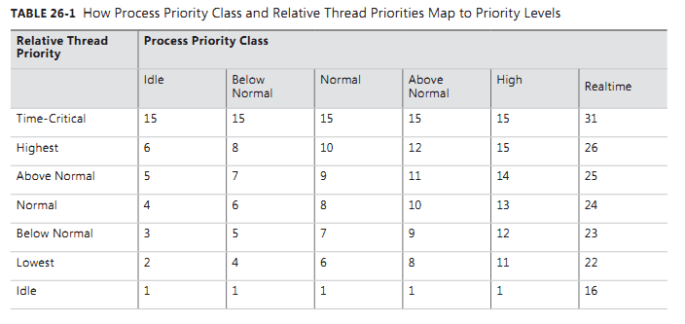
Relationship

Slide 13
Foreground Threads vs. Background Threads
When all the foreground threads in a process stop running, the CLR forcibly ends any background threads that are still running.
Demo…

Slide 14
Asynchronous Operations
Compute-Bound & I/O Bound

Slide 15
Using a Dedicated Thread
Demo…

Slide 16
CLR Thread Pool
Why CLR’s Thread Pool
static Boolean QueueUserWorkItem(WaitCallback callBack);
static Boolean QueueUserWorkItem(WaitCallback callBack, Object state);
Worker & I/O Thread
Execution context
Cooperative Cancellation and Timeout
Demo…(QueueUserWorkItem &E xecution context& Cancellation )

Slide 17
TPL(Task Parallel Library )
Why TPL?
Task
ContinueWith
TaskFactory
TaskScheduler
Parallel For,Foreach
Demo…

Slide 18
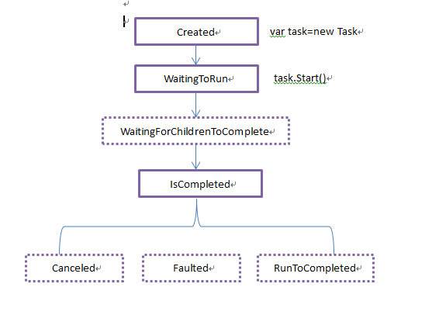
Task.Status

Slide 19
APM(Asynchronous Programming Model)
Performs I/O Operations
How Windows Performs I/O Operations

Slide 20
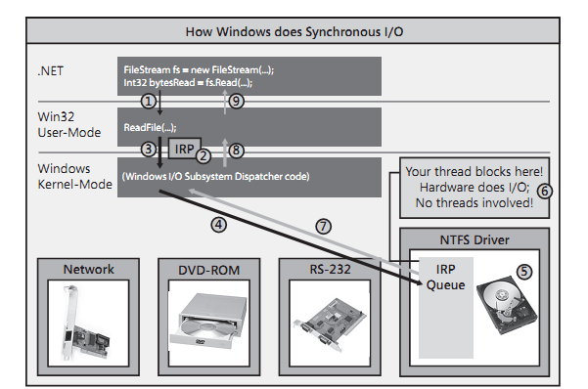

Slide 21
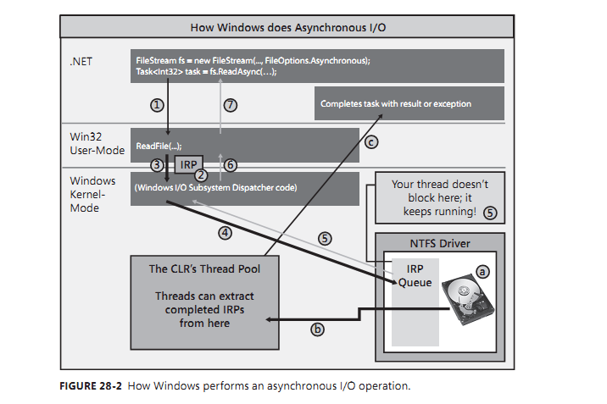

Slide 22
IAsyncResult
Name | Description
AsyncState | Gets a user-defined object that qualifies or contains information about an asynchronous operation.
AsyncWaitHandle | Gets a WaitHandle that is used to wait for an asynchronous operation to complete.
CompletedSynchronously | Gets a value that indicates whether the asynchronous operation completed synchronously.
IsCompleted | Gets a value that indicates whether the asynchronous operation has completed.

Slide 23
4 common ways for APM
http://msdn.microsoft.com/en-us/library/2e08f6yc(v=vs.110).aspx
Do some work and then call EndInvoke to block until the call completes.
Obtain a WaitHandle using the IAsyncResult.AsyncWaitHandle property, use its WaitOne method to block execution until the WaitHandle is signaled, and then call EndInvoke.
Poll the IAsyncResult returned by BeginInvoke to determine when the asynchronous call has completed, and then call EndInvoke.
Pass a delegate for a callback method to BeginInvoke. The method is executed on a ThreadPool thread when the asynchronous call completes. The callback method calls EndInvoke.
Demo…

Slide 24
EAP(Event-based asynchronous pattern )
Demo…

Slide 25
C# Async Functions
Async & Await.
How the compiler Transforms an Async Function into a State Machine

Slide 26
Async&Await
You should be aware of the following restrictions related to async functions:
You cannot turn your application’s Main method into an async function. In addition, constructors, property accessor methods and event accessor methods cannot be turned into async functions.
You cannot have any out or ref parameters on an async function.
You cannot use the await operator inside a catch, finally, or unsafe block.
You cannot take a lock that supports thread ownership or recursion before an await operator and release it after the await operator. The reason is because one thread might execute the code before the await and a different thread might execute the code after the await. If you use await within a C# lock statement, the compiler issues an error. If you explicitly call Monitor’s Enter and Exit methods instead, then the code will compile but Monitor.Exit will throw a SynchronizationLockException at run time.
Within a query expression, the await operator may only be used within the first collection expression of the initial from clause or within the collection expression of a join clause.

Slide 27
ISynchronizeInvoke
Demo

Slide 28
SynchronizationContext
http://msdn.microsoft.com/zh-cn/magazine/gg598924.aspx

Slide 29
Thread Synchronization Constructs
Primitive&Hybrid

Slide 30
Thread synchronization
Thread synchronization is used to prevent corruption when multiple threads access shared data at the same time

Slide 31
Primitive Construct
User-Mode
Kernel-Mode

Slide 32
User-Mode Construct
Volatile Constructs
Interlocked Constructs
Simple Spin Lock
Demo…

Slide 33
Volatile Constructs
Compiler optimization
Demo…(OptimizedAwayDemo.cs)

Slide 34
Interlocked Constructs
See the Demo in Simple Spin Lock…

Slide 35
Kernel-Mode Constructs
WaitHandle
Event Constructs
Semaphore Constructs
Mutex Constructs

Slide 36
Hybrid Construct
Monitor
Double-Check Locking Technique

Slide 37
thread-safe
A thread-safe method means that data doesn’t get corrupted if two threads
attempt to access the data at the same time

